Slide 1


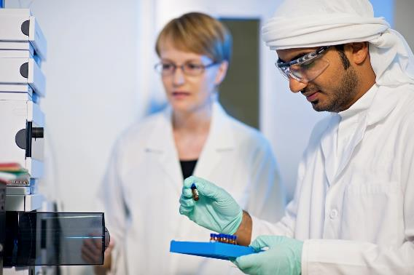
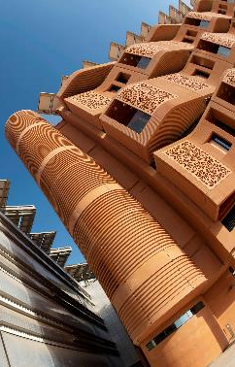
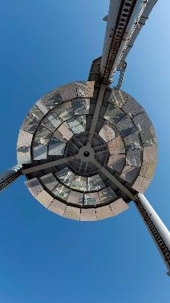
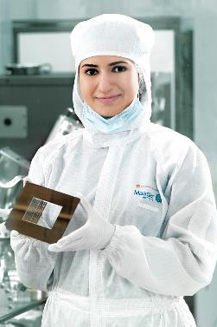
Research Computing requirements
Survey results

Slide 2
Overall Response to survey
We received a total of 106 responses to the survey
66 responses from the Petroleum Institute.
25 responses from Masdar Institute (from a total of ~ 85 faculty).
12 responses from Khalifa University.
3 respondents did not include personal information.
95 were faculty members
The remaining 11 were a mixture of research engineers, visiting faculty, department chairs and one PhD student.
Of the 106 respondents 84 had researchers, postdoc or grad students reporting to them. 22 had no direct reports
Combined these respondents were responsible for:
112 researchers, 64 post docs and 291 graduate students.
This seems to be a good sample size.

Slide 3
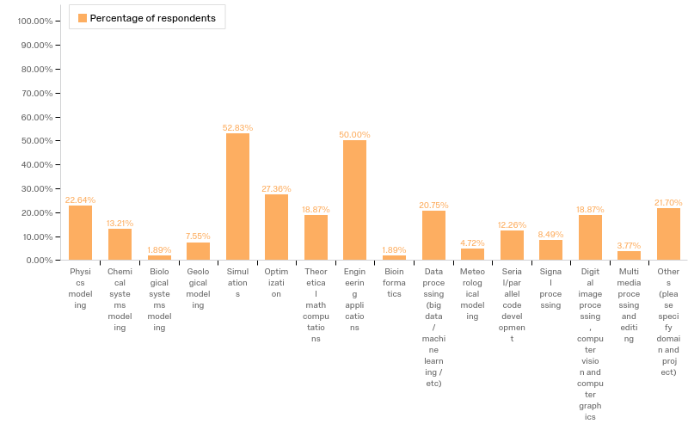
Q2.5 - Do you have any active projects in one of the following research areas?

Slide 4
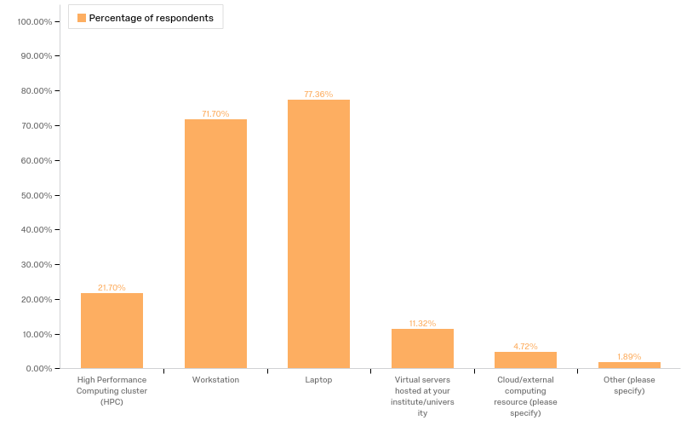
Q3.1 - Currently, how do you conduct research computing ? Select all that apply

Slide 5
Q3.1 - Currently, how do you conduct research computing ? Select all that apply contd.
A substantial portion of the researchers access HPC, but there is clearly room for improvement
Those that selected external computing predominantly use Amazon Web Services, with one selecting a different cloud provider
Two respondents selected “other”
One specified a computer lab
One specified their own cloud cluster, i.e. they run their own in-house cloud cluster

Slide 6
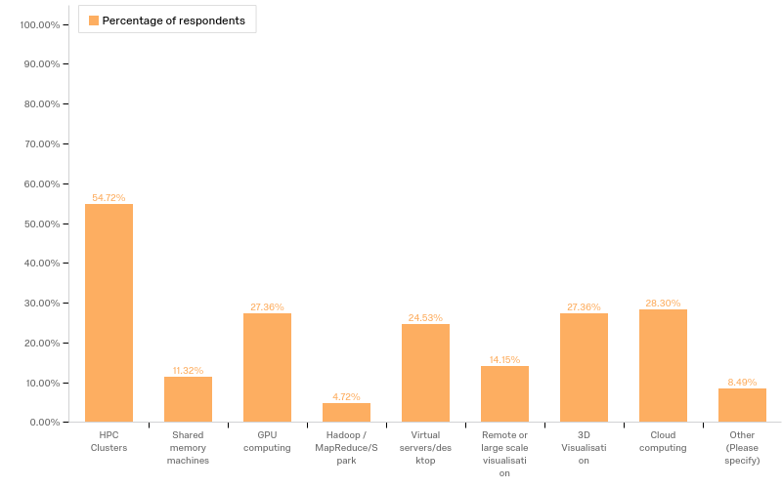
Q3.2 - What HPC / research computing technology do you want or hope to use over the next two years? Select all that apply

Slide 7
Q3.2 - What HPC / research computing technology do you want or hope to use over the next two years? Contd.
There seems to be a clear requirement for HPC resources, followed closely by requirement for GPU computing, virtualization technology (combining cloud and virtual servers as they are essentially the same), and visualization.
The entries specified under “other” were either a variation on “N/A” and one response specified a statistics package called SPSS.
These can be safely ignored.

Slide 8
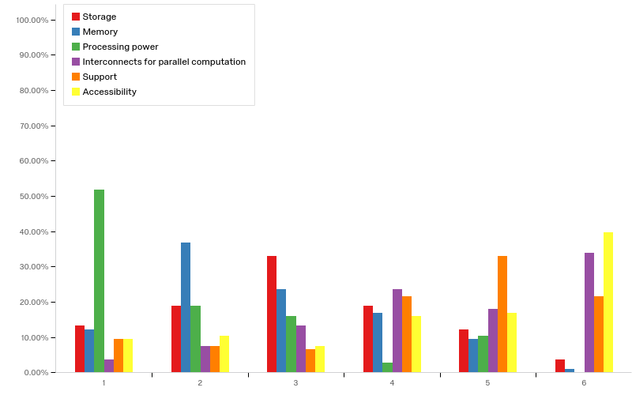
Q3.3 - Please rank the following in terms of importance , most important first.

Slide 9
Q3.3 - Please rank the following in terms of importance , most important first.
Unsurprisingly, there is a clear emphasis on the importance of processing power, memory and storage.
Though very close, in my estimation support seems slightly more important than Interconnects for parallel computation.

Slide 10
Q3.4 - Overall, are the current research computing facilities adequate for your research? Are you able to address your research questions with current resources?
69% - “Yes, I am happy with current provision”
31% - “No, I am unable to carry out some research…”
Q3.5 - What are you is it that you are unable to do? E.g. study a larger system, more time steps, finer mesh etc..
The comments were overwhelmingly about studing larger systems, or using finer meshes. I.e. No comments about new technolgies or other change in direction.
There were a few comments about lack of knowledgable/adequate support both in terms of system adminsitration and HPC specific user support.

Slide 11
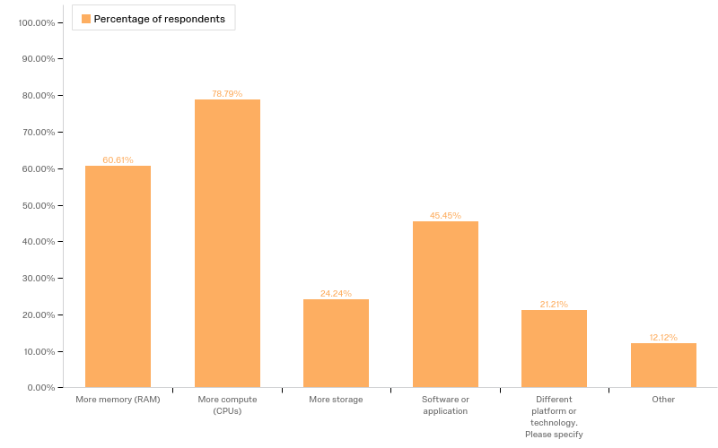
Q3.6 - What resource or tools do you need to remove these limitations?

Slide 12
Q3.6 - What resource or tools do you need to remove these limitations? Contd.
There is an emphasis on processing power and memory, with software applications being another important concern for the researchers.
The comments under “Different platform…” and “Other” mainly concentrated on the need for support, and only a single response mentioning GPUs and another mentioning a different CPU architecture.

Slide 13
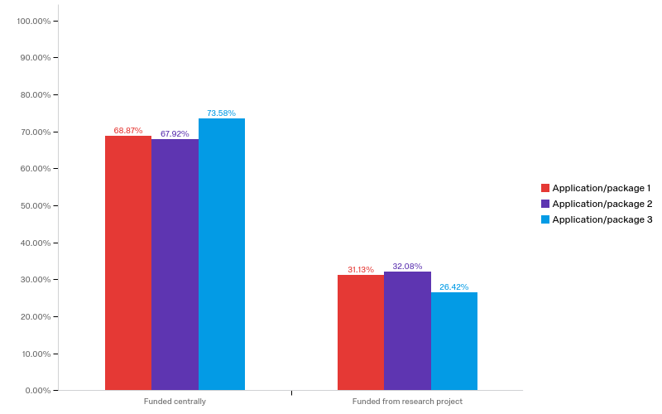
Q4.1 What are the top three essential software applications for your research ? Are they funded centrally or from research budget?

Slide 14
Q4.1 What are the top three essential software applications for your research ? Are they funded centrally or from research budget? Contd.
The majority of essential software is funded centrally.
There was a large number of distinct applications specified, ~145 in total.
The top three software applications by percentage of responses were:
Matlab – 49%
Comsol – 12%
Ansys Fluent - 8%
Due to the large number of responses and software packages, more analysis is needed for this question.
It is important to note that for the majority of applications there was only a single response specifying it.

Slide 15
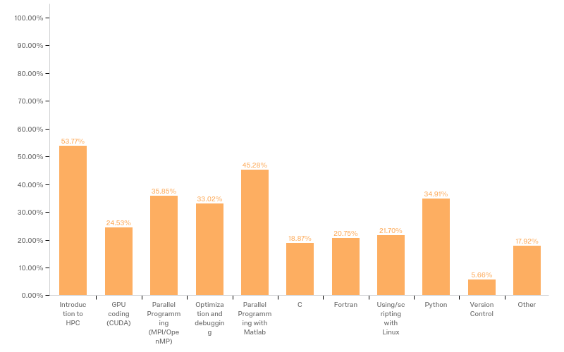
Q4.2 - What training courses would you find useful, pick all that apply

Slide 16
Q4.2 - What training courses would you find useful, pick all that apply:
Contd.
There is a clear desire for more training on HPC, and for courses that will assist researchers with the development of their own code.
Given the popularity of Matlab, the requirement for a parallel programming course with Matlab is not surprising.
With a quarter of respondents interested in GPU coding, there is definite need for this course.

Slide 17
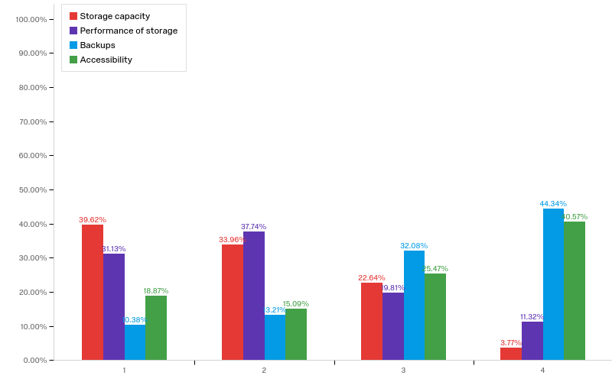
Q5.1 - Specifically for research data storage, please rank the following characteristics in order of importance, most important first

Slide 18
Q5.1 - Specifically for research data storage, please rank the following characteristics in order of importance, most important first. Contd.
As expected, the majority give importance to capacity and performance of the storage systems.
This reinforces the need for large scale parallel file systems.
Backups are given slightly more importance that accessibility, which is a little surprising.

Slide 19
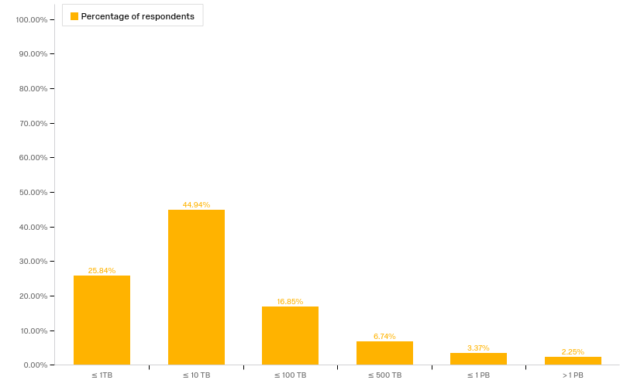
Q5.2 - How much storage do you need for your research data over the next two years?

Slide 20
Q5.2 - How much storage do you need for your research data over the next two years? Contd.
To put these numbers in context, currently research computing at Masdar have a total ~ 400Tb of storage, PI reported ~460Tb and 24Tb at Khalifa.
Q6.1 - How do you see your requirements changing over the next two years? For, instance do you anticipate a demand for new technologies? If so, what are they?
Generally, the comments were either stating that no change in technology or software is expected, or to ask for more compute power, support, and storage.

Slide 21
Q6.2 - Do you wish to add any other comments? e.g. specific application support or anything else we may have missed?
There was an emphasis on the need for support, both system administration and user support.
A few comments were around the desire to access HPC resources from all 3 institutions.
Central funding for key software applications was also mentioned.

Slide 22
Conclusion
The survey results strongly suggest that there is a large need for HPC resources
Some of this need is being met, but clearly more needs to be done
The emphasis is currently on more compute capacity, with storage being a secondary concern
The need for support, both system admin and user support, is another common theme
There is a need for basic HPC training as well as courses to enable researchers to better develop their own code, and make use of existing GPU resources

